Slide 1
Pertemuan ke_12 dan 13 FIRST ORDER LOGIC
PROGRAM STUDI TEKNIK INFORMATIKA
MATA KULIAH
Logika Informatika
Tim pengampu
2022

Slide 2
PROGRAM STUDI
TEKNIK INFORMATIKA
MATA KULIAH
Logika Informatika
Capaian Pembelajaran
Setelah mempelajari materi ini mahasiswa diharapkan dapat menjelaskan merubah dalam bentuk Clausal Form pada Logika Predikat
Setelah mempelajari materi ini mahasiswa diharapkan dapat menjelaskan aturan iferensi FoL

Slide 3
Clausal Form
PROGRAM STUDI
TEKNIK INFORMATIKA
MATA KULIAH
Logika Informatika
The unique form is called Clausal Form (since it involves a combination of `clauses’). There are various versions, and we will learn a common version.
A conjunction of disjunctions looks like this:
i.e. a list of things joined by ANDs, where each thing is either an `atomic’ predicate (maybe negated) or a list of atomic predicates joined by ORs.
ANY statement in predicate logic can be converted to a such a conjunction of disjunctions. The result is in what we call:
Conjunctive Normal Form
$$(A∨¬B)∧(C∨¬A∨D)∧E∧(¬F∨G)∧...$$

Slide 4
A Procedure for Clausal Form (INSEADO)
PROGRAM STUDI
TEKNIK INFORMATIKA
MATA KULIAH
Logika Informatika
1. Implications out (I)
2. Negations in (N)
3. Standardize variables (S)
4. Existentials out (E)
5. Alls out (A)
6. Disjunctions in (D)
7. Operators out(O)

Slide 5
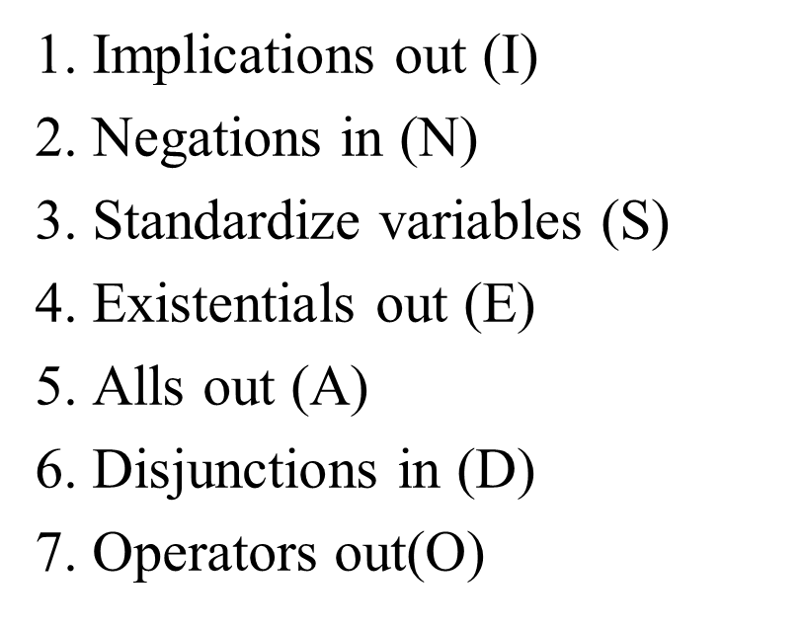
A Procedure for Clausal Form (INSEADO)
PROGRAM STUDI
TEKNIK INFORMATIKA
MATA KULIAH
Logika Informatika
1. Implications out (I)
Menghilangkan kejadian: ⇒, ⇐, and ⇔ operators
φ ⇒ ψ | → | ¬ φ ∨ ψ
φ ⇐ ψ | → | φ ∨ ¬ψ
φ ⇔ ψ | → | (¬φ ∨ ψ) ∧ (φ ∨ ¬ψ)
Ψ : psi
φ : varphi

Slide 6
A Procedure for Clausal Form (INSEADO)
PROGRAM STUDI
TEKNIK INFORMATIKA
MATA KULIAH
Logika Informatika
2. Negations in (N)
Negasikan operator logis dan quantifiers lainnya
¬ ¬φ | → | φ
¬(φ ∧ ψ) | → | ¬φ ∨ ¬ψ
¬(φ ∨ ψ) | → | ¬φ ∧ ¬ψ
¬∀ν. φ | → | ∃ν.¬φ
¬∃ν.φ | → | ∀ν.¬φ

Slide 7
A Procedure for Clausal Form (INSEADO)
PROGRAM STUDI
TEKNIK INFORMATIKA
MATA KULIAH
Logika Informatika
3. Standardize variables (S)
Mengganti nama variabel sehingga setiap kuantor memiliki variable unik
4. Existentials out (E)
Mengganti semua existential quantifiers. Konstansta digunakan untuk mengganti existential variable, yang dinamakan Skolem constant (atau bisa juga sebuah fungsi).
∀x.(p(x) ⇒ ∃x.q(x)) | → | ∀x.(p(x) ⇒ ∃y.q(y))
∃x.p(x) | → | p(a)
∀x.(p(x) ∧ ∃z.q(x, y, z)) | → | ∀x.(p(x) ∧ q(x, y, f(x, y)))

Slide 8
A Procedure for Clausal Form (INSEADO)
PROGRAM STUDI
TEKNIK INFORMATIKA
MATA KULIAH
Logika Informatika
∀x.(p(x) ∧ q(x, y, f(x, y))) | → | p(x) ∧ q(x, y, f(x, y))
5. Alls out (A)
Keluarkan semua universal quantifiers
6. Disjunctions in (D)
Merubah ekspresi ke dalam bentuk normal konjungtif, yaitu konjungsi dari disjungsi literal
φ ∨ (ψ ∧ χ) | → | (φ ∨ ψ) ∧ (φ ∨ χ)
(φ ∧ ψ) ∨ χ | → | (φ ∨ χ) ∧ (ψ ∨ χ)
φ ∨ (φ₁ ∨ ... ∨ φ_{n}) | → | φ ∨ φ₁ ∨ ... ∨ φ_{n}
(φ₁ ∨ ... ∨ φ_{n}) ∨ φ | → | φ₁ ∨ ... ∨ φ_{n} ∨ φ
φ ∧ (φ₁ ∧ ... ∧ φ_{n}) | → | φ ∧ φ₁ ∧ ... ∧ φ_{n}
(φ₁ ∧ ... ∧ φ_{n}) ∧ φ | → | φ₁ ∧ ... ∧ φ_{n} ∧ φ

Slide 9
A Procedure for Clausal Form (INSEADO)
PROGRAM STUDI
TEKNIK INFORMATIKA
MATA KULIAH
Logika Informatika
7. Operators out(O)
Eliminate operators by separating any conjunctions into its conjuncts and writing each disjunction as a separate clause
φ₁ ∧ ... ∧ φ_{n} | → | {φ_{1},}
 | → | ...
 | → | {φ_{n}}
φ₁ ∨ ... ∨ φ_{n} | → | {φ₁, ... , φ_{n}}

Slide 10
Contoh 1:
PROGRAM STUDI
TEKNIK INFORMATIKA
MATA KULIAH
Logika Informatika
 | ∀x.(pintar(x) ⇒ lulus_tepatwaktu(x))
I | ∀x.(¬ pintar(x) ∨ lulus_tepatwaktu(x))
N | ∀x.(¬ pintar(x) ∨ lulus_tepatwaktu(x)) (tetap)
S | ∀x.(¬ pintar(x) ∨ lulus_tepatwaktu(x)) (tetap)
E | ∀x.(¬ pintar(x) ∨ lulus_tepatwaktu(x)) (tetap)
A | ¬ pintar(x) ∨ lulus_tepatwaktu(x)
D | ¬ pintar(x) ∨ lulus_tepatwaktu(x)
O | {¬ pintar(x), lulus_tepatwaktu(x)}
 | {lulus_tepatwaktu(x), ¬ pintar(x)} (diurutkan lebih baik)

Slide 11
Contoh 2:
PROGRAM STUDI
TEKNIK INFORMATIKA
MATA KULIAH
Logika Informatika
 | ¬ (∀x.(pintar(x) ∧ rajin(x)))
I | ¬ (∀x.(pintar(x) ∧ rajin(x))) (tetap)
N | ∃x.(¬ pintar(x) ∨ ¬ rajin(x))
S | ∃x.(¬ pintar(x) ∨ ¬ rajin(x)) (tetap)
E | ¬ pintar(Bejo) ∨ ¬ rajin(Bejo)
A | ¬ pintar(Bejo) ∨ ¬ rajin(Bejo) (tetap)
D | ¬ pintar(Bejo) ∨ ¬ rajin(Bejo) (tetap)
O | {¬ pintar(Bejo), ¬ rajin(Bejo)}

Slide 12
Contoh 3:
PROGRAM STUDI
TEKNIK INFORMATIKA
MATA KULIAH
Logika Informatika
 | ∃y.(g(y) ∧ ∀z.(r(z) ⇒ f(y, z)))
I | ∃y.(g(y) ∧ ∀z.(¬r(z) ∨ f(y, z)))
N | ∃y.(g(y) ∧ ∀z.(¬r(z) ∨ f(y, z))) (tetap)
S | ∃y.(g(y) ∧ ∀z.(¬r(z) ∨ f(y, z))) (tetap)
E | g(gary) ∧ ∀z.(¬r(z) ∨ f(gary, z))
A | g(gary) ∧ (¬r(z) ∨ f(gary, z))
D | g(gary) ∧ (¬r(z) ∨ f(gary, z))
O | {g(gary)},
 | {¬r(z), f(gary, z)}

Slide 13
Contoh 4:
PROGRAM STUDI
TEKNIK INFORMATIKA
MATA KULIAH
Logika Informatika
 | ¬ (∃y.(g(y) ∧ ∀z.(r(z) ⇒ f(y, z))))
I | ¬ (∃y.(g(y) ∧ ∀z.(¬r(z) ∨ f(y, z))))
N | ∀y.(¬(g(y) ∧ ∀z.(¬r(z) ∨ f(y, z)))
 | ∀y.(¬g(y) ∨ ¬∀z.(¬r(z) ∨ f(y, z)))
 | ∀y.(¬g(y) ∨ ∃z.¬(¬r(z) ∨ f(y, z)))
 | ∀y.(¬g(y) ∨ ∃z.(¬¬r(z) ∧ ¬f(y, z)))
 | ∀y.(¬g(y) ∨ ∃z.(r(z) ∧ ¬f(y, z)))
S | ∀y.(¬g(y) ∨ ∃z.(r(z) ∧ ¬f(y, z)))
E | ∀y.(¬g(y) ∨ (r(k(y)) ∧ ¬f(y, k(y))))
A | ¬g(y) ∨ (r(k(y)) ∧ ¬f(y, k(y)))
D | (¬g(y) ∨ r(k(y))) ∧ (¬g(y) ∨ ¬f(y, k(y)))
O | {¬g(y), r(k(y))}
 | {¬g(y), ¬f(y, k(y))}

Slide 14
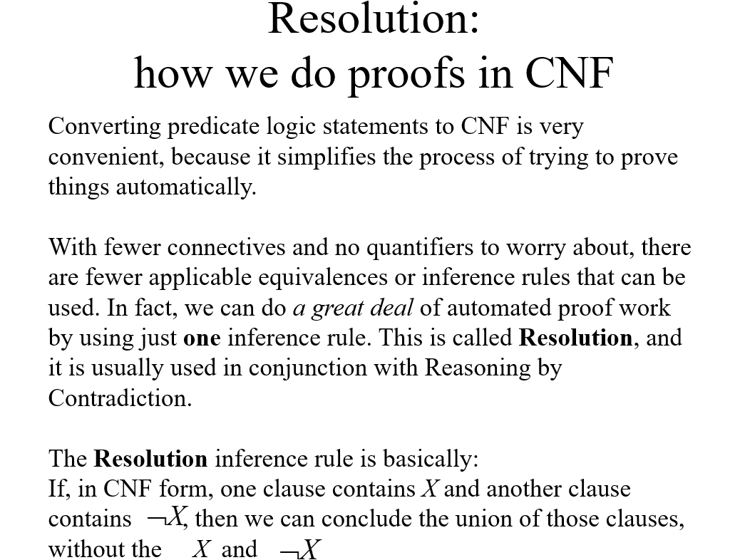
PROGRAM STUDI
TEKNIK INFORMATIKA
MATA KULIAH
Logika Informatika

Slide 15
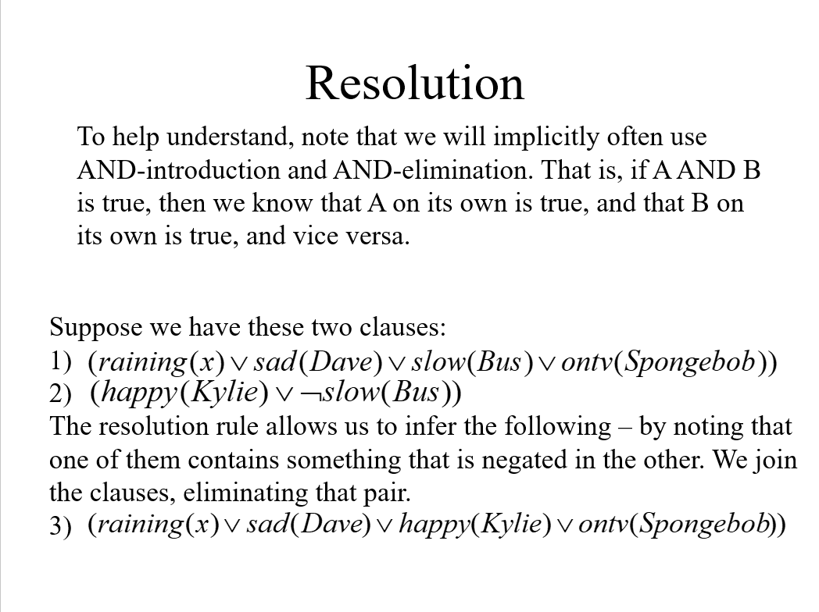
PROGRAM STUDI
TEKNIK INFORMATIKA
MATA KULIAH
Logika Informatika

Slide 16
PROGRAM STUDI
TEKNIK INFORMATIKA
MATA KULIAH
Logika Informatika
The Clausal form is :
Result of resolution:

Slide 17
Is it valid?
PROGRAM STUDI
TEKNIK INFORMATIKA
MATA KULIAH
Logika Informatika
Of course it is. But it is worth thinking about it to convince yourself
Think of the simple case where you have:
Clearly, resolution now gives us:
3)
We could prove it in a longer way by:
{Implication rule}
4)
{follows from 2 and 4}
5)

Slide 18
1. Convert the following statements to predicate logic
PROGRAM STUDI
TEKNIK INFORMATIKA
MATA KULIAH
Logika Informatika
SOAL-SOAL
Jack owns a dog
Every dog owner is an animal lover.
The cat’s name is Tuna.
Apple and vegetable are food
Harry eats everything that Anil eats.
2. Convert Predicate Logic in no. 1 to Clausal Form

Slide 19
PROGRAM STUDI
TEKNIK INFORMATIKA
MATA KULIAH
Logika Informatika
3. Ubahlah FoL berikut ke dalam Bentuk Klausal
a. $x Father(x, Bill) Ù Mother(x, Hillary)
b. " x (Passtest(x) Ú ($x ShootDave(x)))
c. " x,y Parent(x,y) Þ Child(y,x)
d. " x " y ( Man(x) Ù Ruler(y) Ù Tryassassinate(x,y)) Þ
Ø Loyalto(x,y)
4. Ubahlah FoL berikut ke dalam Bentuk Klausal (Soal Dari UAS)
a. ¬(∃ x (Male( x) Þ Menyukai( x, Motor))
b. ∀x ((See (x, Tamara) ∧ Smart (Tamara)) Þ love (x, Tamara))
5. Prove the following statements is valid using resolution (predicate logic)
All men are mortal (Premis)
Socrates is a man. (Premis)
Therefore Socrates is mortal (kesimpulan)

